Slide 1
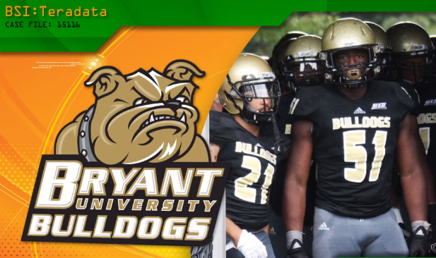

HOW WE DID IT Business Scenario Investigations (BSI) Episode 13: “Case of Precision Football”
HOW WE DID IT
Send Questions or Comments to
drdaveschrader@gmail.com
Notes:
Scene 0.1

Slide 2
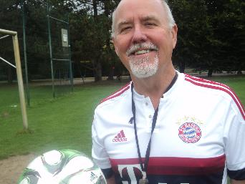
NOTE TO Readers
This is the storyboard for the BSI Teradata “Case of Precision Football”, which includes all the topics shown in the video but also some extra analysis not shown because of time constraints
Thanks for viewing the episode and reading this HOW WE DID IT note
Dr. Dave

Slide 3
Credits
Thanks to Teradata University Network, SAS, and Bryant University for their help in the development and funding of this episode
Special thanks to Coach Marty Fine and the Bryant Bulldog students, coaches, and athletes who let us use their images in this episode
While the people are real, the episode story is – like all BSI episodes – fictitious. However, everything shown in this episode is doable. We hope it inspires more sports teams to use analytics to improve, and students to study sports analytics!

Slide 4

Synopsis
Scene 1: The Coach’s Problems
Scene 2: Brainstorming Ideas to Improve
Scene 3: Constructing Analytics
Scene 4: The Results!

Slide 5
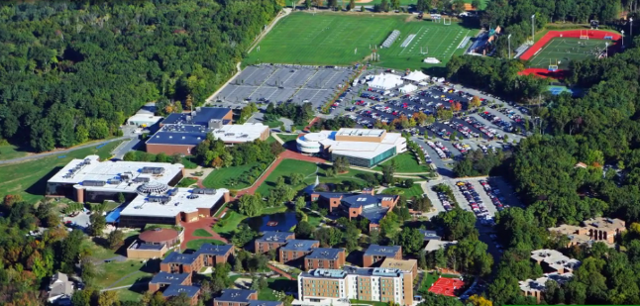
Intro - Bryant University
Located in beautiful Smithfield, Rhode Island
3700 students, many studying business
One of the smallest schools in NCAA Division 1 sports
Competes in the Northeast Conference in 10 men’s and 10 women’s sports
https://en.wikipedia.org/wiki/Bryant_Bulldogs

Slide 6
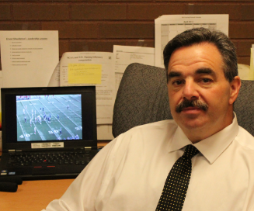
Meet the Bryant Bulldogs Football Coach
In our story, Coach Fine wants to “up the game” for his football team
He has heard about analytics for football but doesn’t know what’s possible

Slide 7
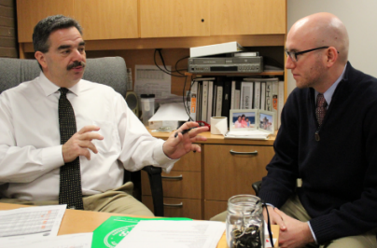
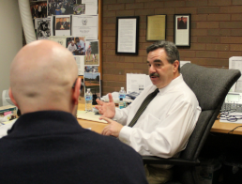
Scene 1 – Coach’s Office Discussions with Receivers Coach Michael (Not in Video)
Coaching tasks could benefit from Analytics
Recruiting
Player development
Game planning
Strength and conditioning
New technologies?
Predictive models, stats
Sensors
Visualizations
Let’s invite in a prof from the Business School to see what might be possible

Slide 8
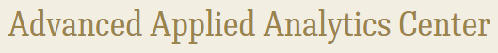
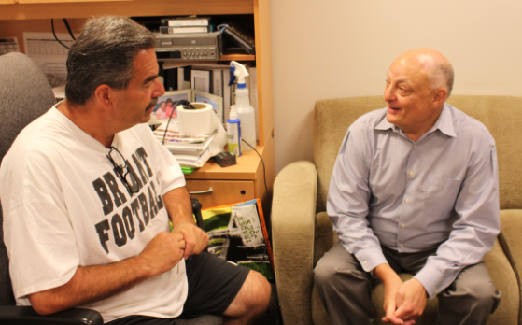
Next Day, After Practice - Coach’s Office Discussions with Prof Glass from the Bryant Business School
Richard heads the Bryant AAAC. He has students who are eager to help the team
Tells the coach that both Duke and Davidson have engaged the rest of their campuses (e.g., Business School, CS department) to help their basketball programs
So why not do the same for football at Bryant?
What are typical problems we could help you with?
http://www.goduke.com/ViewArticle.dbml?ATCLID=209730843

Slide 9
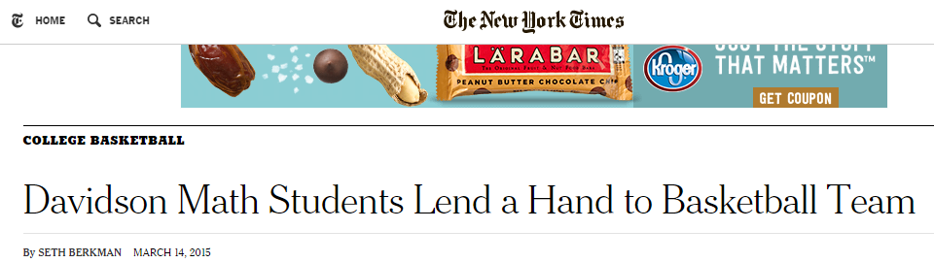
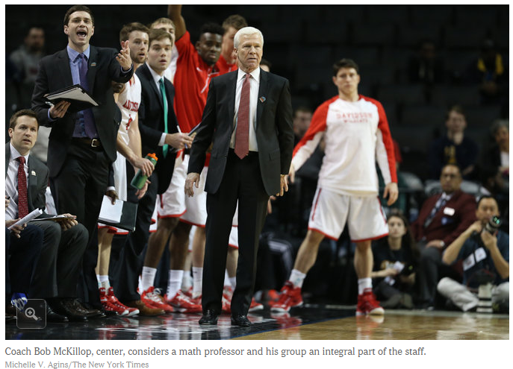
SIDE READING
http://www.nytimes.com/2015/03/15/sports/ncaabasketball/davidson-math-students-lend-a-hand-to-basketball-team.html?_r=0
To prepare for the spotlight, Coach McKillop and his staff had homed in on a secret weapon. They did not recruit an unknown European marksman or a graduate transfer, but a math professor and a group of students infatuated with basketball statistics.
Notes:
http://www.nytimes.com/2015/03/15/sports/ncaabasketball/davidson-math-students-lend-a-hand-to-basketball-team.html?_r=0

Slide 10
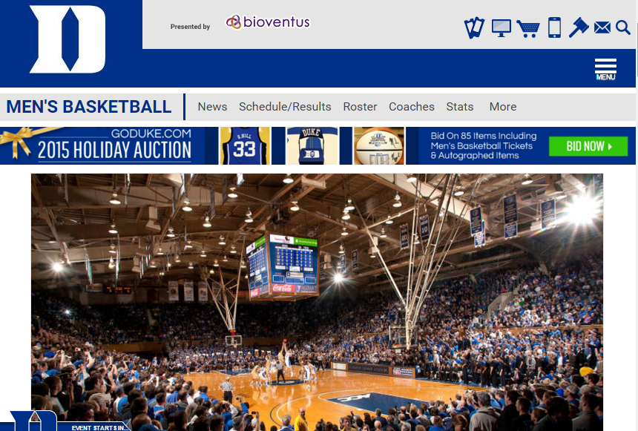
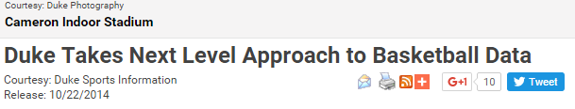
Duke
SIDE READING
“MBA students at Duke University’s Fuqua School of Business, in cooperation with SAP and NTT Data, have developed a groundbreaking visual dashboard to enable Blue Devil Fans to interact with the team’s historical record book.”
http://www.goduke.com/ViewArticle.dbml?ATCLID=209730843

Slide 11
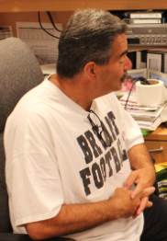
Problem 1 – Recruiting Wide Receivers
“We will invite in 20 high school juniors in for an evaluation day this summer.
Today we measure speed, size of hands, lengths of arm, fit with our system, and their height/weight on this chart”
But is there a better way to pick out our future receivers?
We only have 3 scholarships for wide receivers so we need to choose carefully

Slide 12
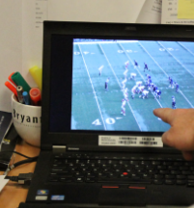
Problem 2 – Player Development – Receivers (and Pass Defenders)
If we could improve our passing game, we can win more games
We have a great experienced QB - but he needs receivers who can run our routes correctly
Inverse problem: We also need to recruit defensive secondary players like safeties and linebackers who can defend passes more tightly

Slide 13
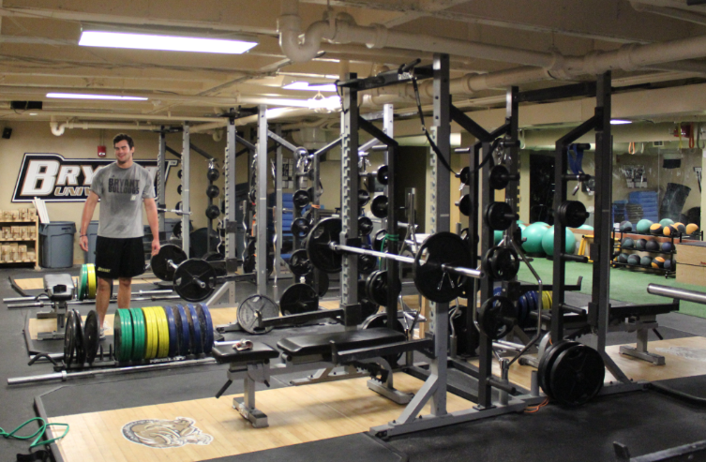
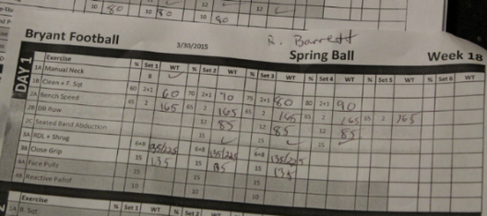
Problem 3 – Strength and Fitness Inefficient Use of Time – Players and Coaches
The NCAA limits contact hours so we need to be efficient.
Athletes need higher quality ways to focus. Our systems are manual, e.g., pen and paper for keeping track of weight room lifts
Could be entered into a database, for access by athletes and coaches, good for trending
Goal: data at our fingertips so both coaches and players are efficient

Slide 14
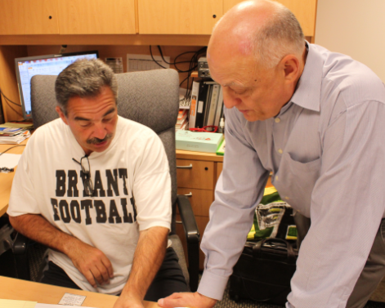
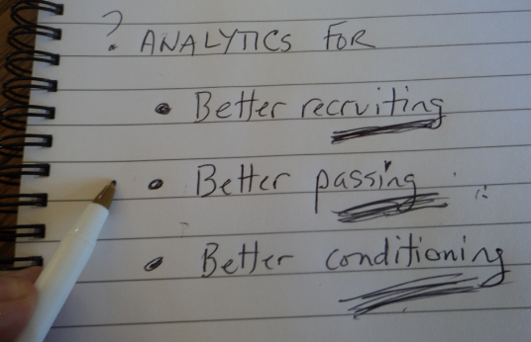
Recap – 3 Areas Where Football Analytics Could Help the Coach

Slide 15
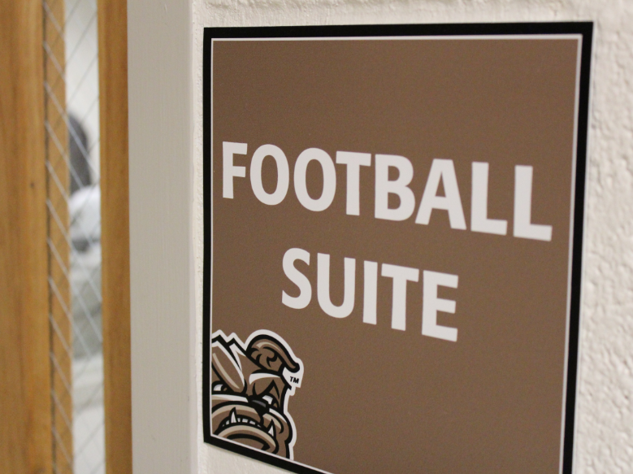
Scene 2
A week later, the BSI Expert Dr Dave shows up for a Brainstorming Meeting.
Let’s listen in ..

Slide 16
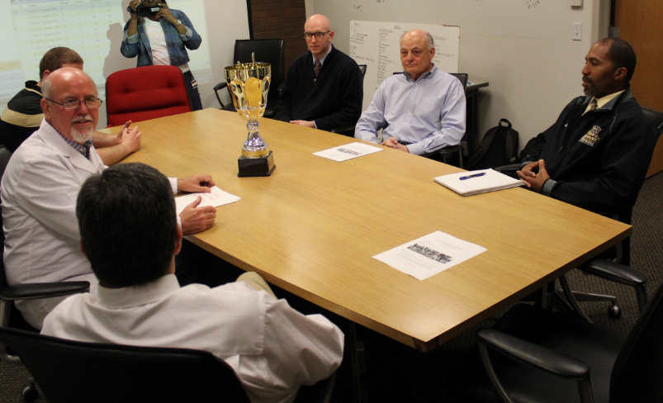
Prof Glass– Biz School Advanced Analytics Lab
Defense
Coordinator
Dr Dave - BSI
Receivers
Coach
Coach Fine
Invites his wide receivers coach and the defensive coordinator to sit in on the brainstorming session with Prof. Glass and Dr. Dave

Slide 17
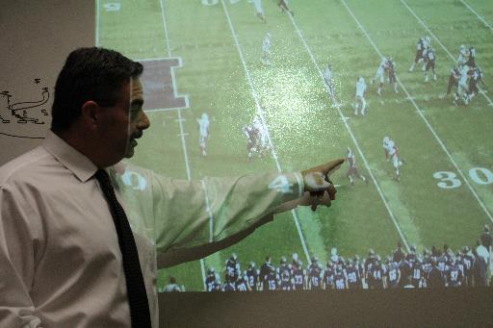
Idea #1 Better Predictive Model Factors for Choosing Recruits
Coach : For wide receivers, beyond speed, it’s important to have fast reaction times so you can catch the ball.
Any way to measure that?

Slide 18

Richard proposes the Lightbulb Test
Idea is to put the recruit in a dark room and instrument how fast he can react to a stimulus (like a Lightbulb “pop” from a single bulb in a light array positioned around the upper perimeter of the room).
This is a proxy test for a receiver running down the field when a pass is already in the air and only a few feet from him – can he correctly locate the ball (and catch it!)
Student is placed in a dark room with headset on
We “pop” a Lightbulb
Then measure 2 things
Speed of head rotation (milliseconds)
Whether the head end position is aimed at the bulb - degrees off–left/right deviation and up/down – (x,y)

Slide 19
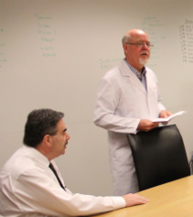
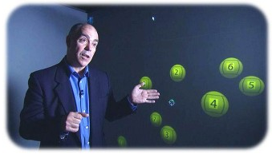
Another Possible Reaction Test: 3D Moving Objects Test (MOT)
Schrader: just came across this great research work at U-Montreal by Prof. Jocelyn Faubert on visual perception testing – might be applicable for receivers – or even linebackers and safeties
http://cognisensathletics.com/science/4585360109
Notes:
A total of 102 professional players (mean age = 23,8 ± 5,5 SD, median 22) from three different sports including 51 professional soccer players (English Premier League (EPL)), 21 professional ice hockey players (National Hockey League (NHL)) and 30 professional rugby players (French Top 14 Rugby League (Top14)). We also tested a total of 173 elite amateurs (mean age = 23,5 ± 5,8 SD, median 22) with 136 from the NCAA university sports program in the US and 37 from a European Olympic sport-training center. We have also tested 33 non-athlete university students (mean age = 23,8 ± 5,0 SD, median 22) from the Université de Montréal.

Slide 20
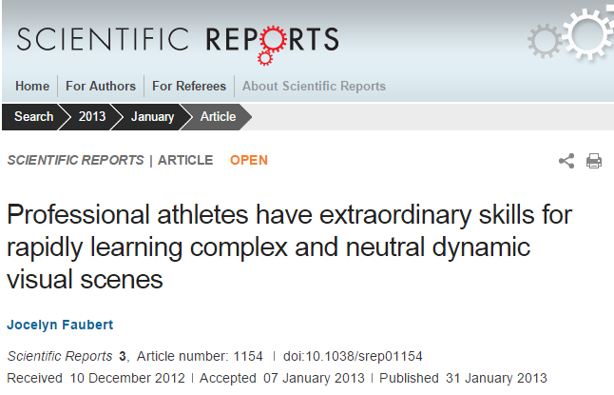

Slide 21
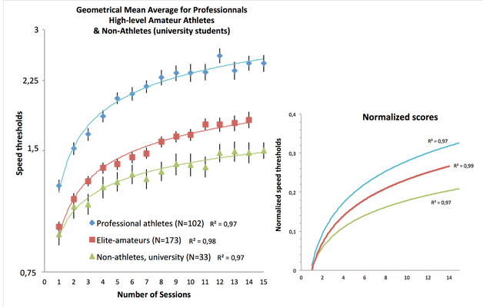
Faubert 3D MOT Test Results
Their results for soccer, ice hockey, and rugby teams looking compelling
We could try out for football recruits
Learning Curves

Slide 22
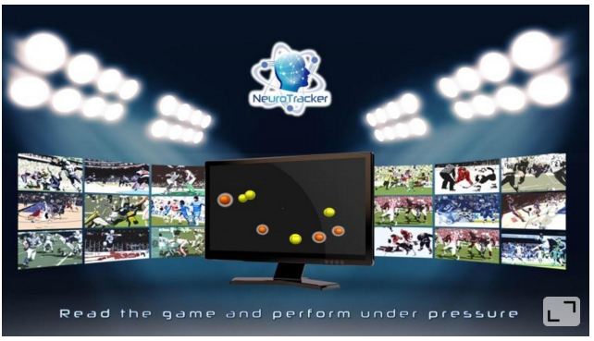
Homework
Read about Prof. Faubert on Wikipedia at: https://en.wikipedia.org/wiki/Jocelyn_Faubert
Access and Read the Full Report at: http://www.nature.com/articles/srep01154
Read about his company CogniSens Athletics at: http://www.fitness-gaming.com/profiles/company/cognisens-athletics.html
(And thanks to Prof. Faubert for allowing us to use his work in this video!)

Slide 23
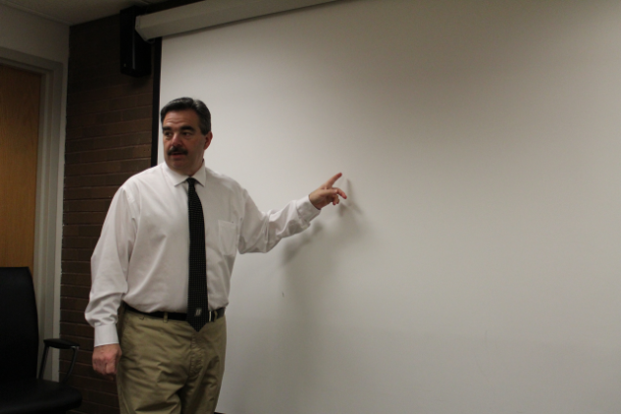
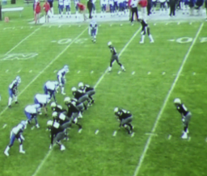
Player Development Idea #2 Precision Route Running
Coach : Idea – it’s hard to defend teams that run great routes. Is there a way to measure our receivers’ ability to run routes?
Dr Dave: If you give us the routes, we could probably use video or GPS data to measure how close to perfection each Receiver runs

Slide 24
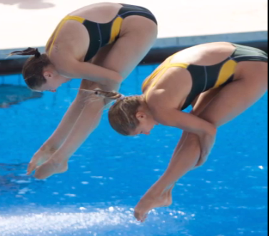
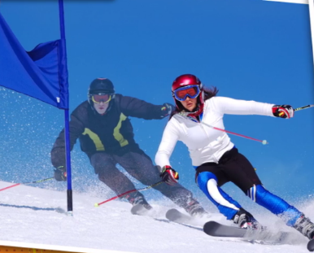
It’s Like the Video Overlays That Measure Perfection for Skiing or Synchronized Diving
Synchronized diving Simulcam video / 2 skiers on
same course

Slide 25
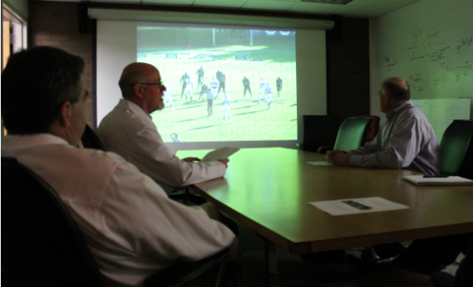
Turn Route Running Into Geometry Problems
Could use video annotations of game film now, maybe also GPS sensors down the road
Another point: If we figure this out for receivers, we could apply the same techniques to measure how well your secondary and linebackers are defending.
it’s a “temporal-geospatial distance” problem, not that hard to compute once we turn the movement into dots in a Cartesian coordinate plane

Slide 26
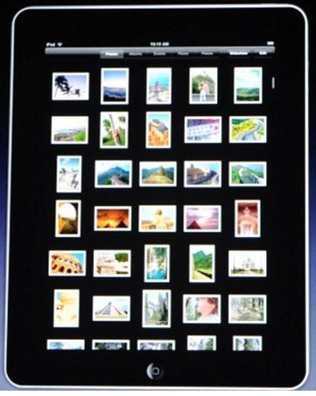
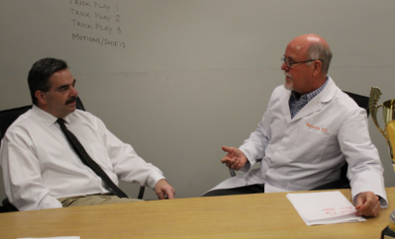
Problem #3: Strength and Conditioning (Not shown in Video)
For the weight training data collection, it’s easy to build some dashboards for both coaches and players
Short term, your players can input information (like weightroom lifts) onto iPads, or mobile devices, avoiding paper
Then we can have students build a database with custom dashboards by player position, along with coach’s annotations

Slide 27
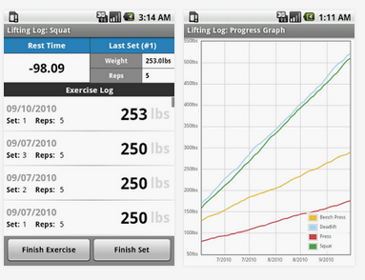
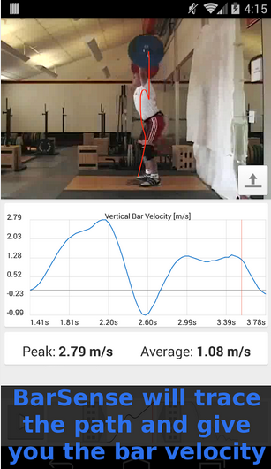
Longer Term: Upgrade Your Weight Room
LiftingLog BarSense
You should take a look at the new generation of weight machines that automatically collect all kinds of information – not just weights - using accelerometers to measure work output
These are app-connected
Source: https://play.google.com/store/apps/details?id=net.kndy.liftinglog&hl=en and
https://play.google.com/store/apps/details?id=com.barsense.main&hl=en
Notes:
http://www.fitness-gaming.com/profiles/company/cognisens-athletics.html

Slide 28
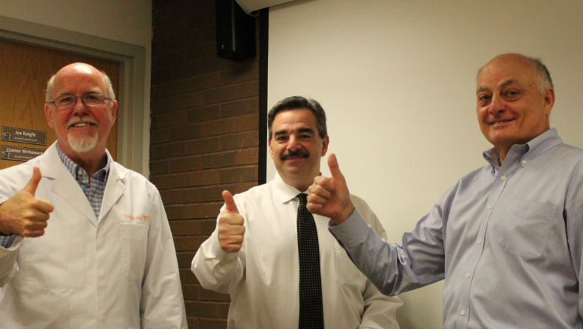
Brainstorming’s Done! We’ll Call It the “Precision Football Project”
And Coach says to proceed

Slide 29
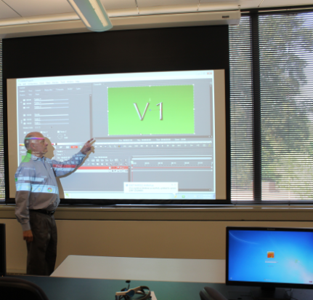
Back at the Advanced Analytics Lab Prof. Glass Recruits Students for the Project
Projects)
Recruiting Predictive Model
Lightbulb Reaction Test
Motion Object Test
Pass Precision Model
Video and/or GPS Sensors
Geometry Models

Slide 30
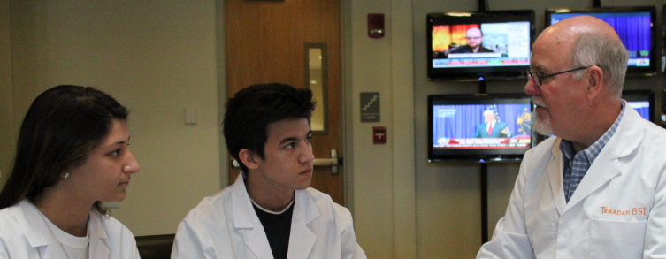
Giana and Kevin Sign Up
Business School students Giana and Kevin sign up to do a capstone project, helping the Bulldogs by building new analytics
BSI Expert Dave explains the project details to them and they split up the analytics work

Slide 31
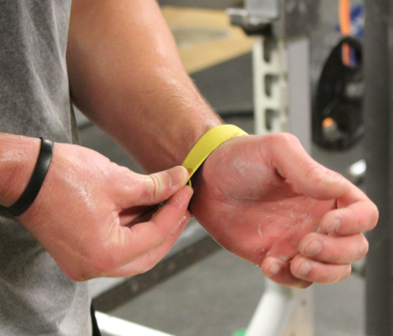
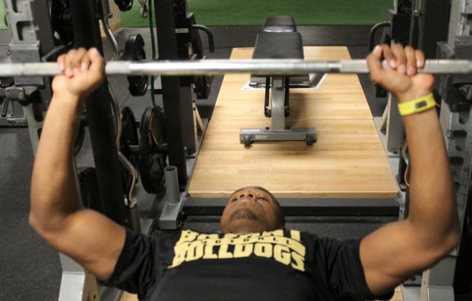
Scene 3 –WEEKS LATER: Readout
“Project Precision Football” is well underway.
The students have made great progress. They collect some data using video and fitness bracelets worn by the players, then come up with some sample analytics to help the coach
Other students help them on building iPAD screens to capture and display weight training info

Slide 32
Side Note: Designing the Measures
There are many options for the scales you might use in the various tests. Here are a few examples.
We mostly used 5 point scales (5 = best)
Test Directionality. Our approach was to make “Bigger Numbers are Better” as a general rule. So for example a faster head rotation time yields a higher score, even though the raw measurement is a smaller amount of time to rotate the head in the best case.
Gaze accuracy was measured in degrees, then normalized to standard deviations (across all the athletes), then mapped to a 5 point scale
Same kind of rule for route running – where both geometric distances were mapped, as well as timing (not shown in the video).

Slide 33
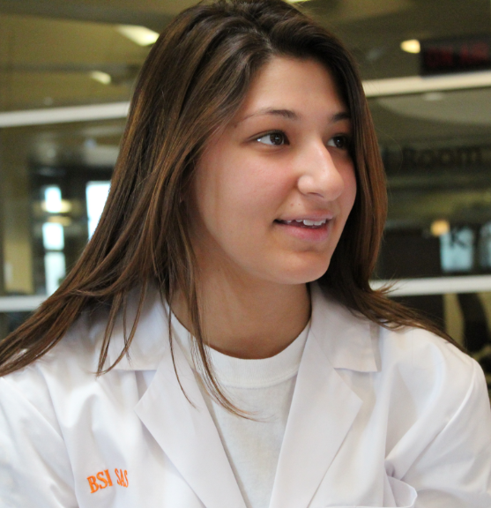
Giana Works On the Reaction Time Studies
She does some online research and comes up with 2 tests
Lightbulb Visual Acuity Test for receivers
3D-MOT Test for receives and linebackers
Coaches line up the recruits/players and she collects the data
Then starts analyzing it

Slide 34
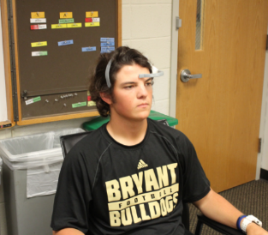
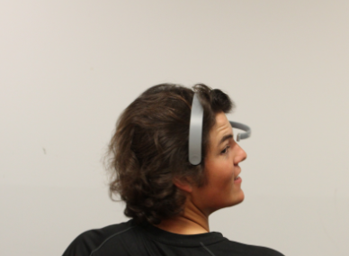
Giana’s Visual Acuity Test
Dark room with an array of light bulbs around the perimeter
She “pops” a bulb stimulus
Then measures, for each of 5 tests:
Quickness of head rotation (msec)
Gaze accuracy (2 dimensions, X,Y)

Slide 35
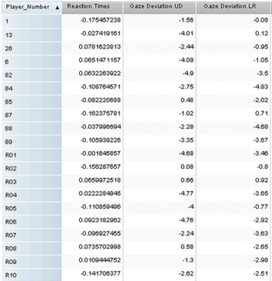
Lightbulb Test Results (courtesy of SAS)
Wide Receivers Reaction Time Test #1 Data
Giana puts the data in the school’s TUN Teradata cloud database, and uses SAS to analyze and visualize the results
She runs the test on current receivers as well as recruits (designated with R#)
Next page shows the result for Recruit #10

Slide 36
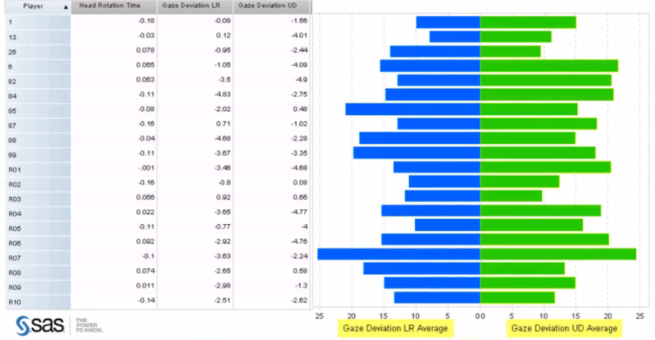

Slide 37
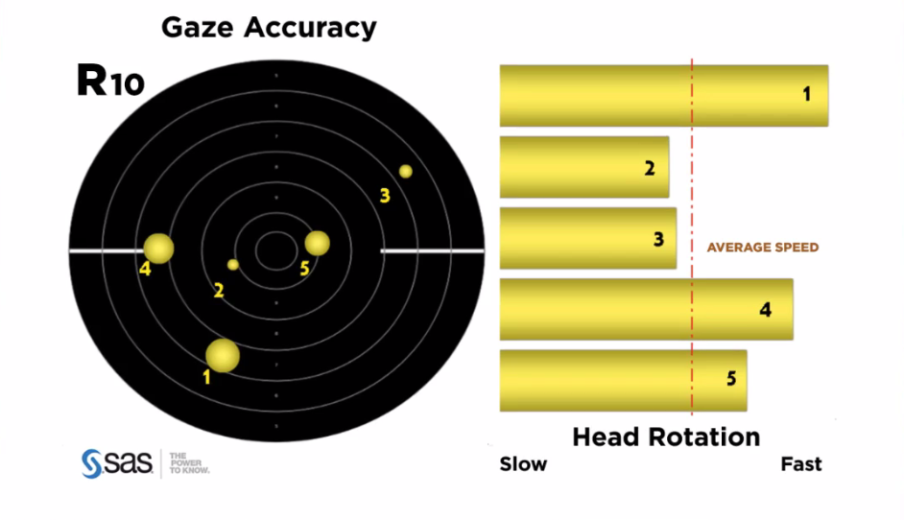

Slide 38
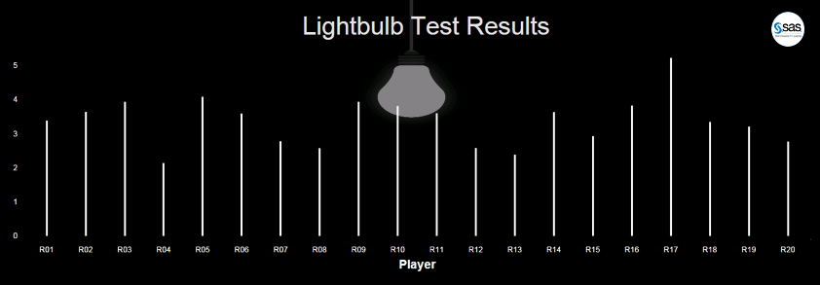
Rankings – Recruits – Lightbulb Test
5 point scale – weighted average of head rotation time and gaze accuracy, across 5 tests
All 20 recruits (only showed 10 in video

Slide 39
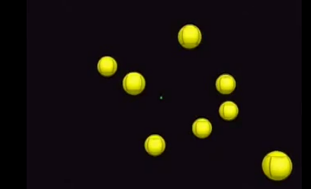
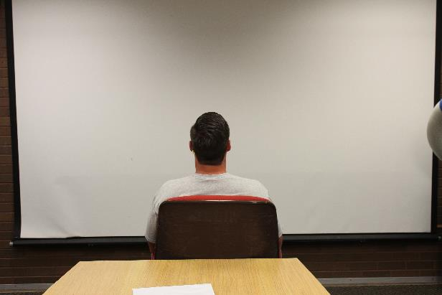
Faubert Test: “3D MOT” 3-dimensional multiple-object-tracking speed threshold task
8 Moving Balls
Stop, highlight 4
You track as they move
Which Ones?
YOU TRY IT!
E.g., run video at https://www.youtube.com/watch?v=_OAgo68dHkg
from 7:36 to 8:40, result in NOTES
Notes:
Answer (3,4,5,8)

Slide 40
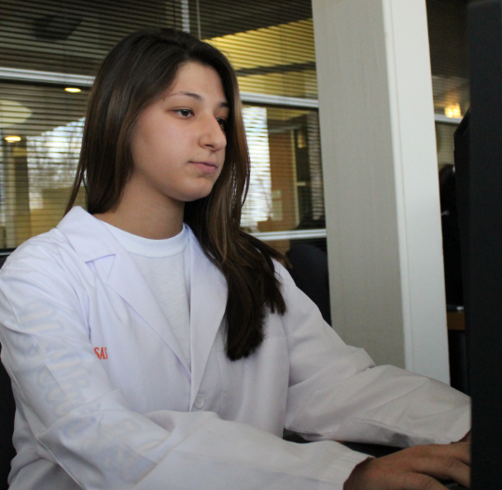
Giana Creates Some Visuals and Reports
After gathering the data, Giana creates reports for the 3D- MOT tests, which show the best wide receiver recruits
Notes:
Scene 3.12

Slide 41

Notes:
Visual 3.13

Slide 42


Concept 2: Kevin works on Precision Route Running
Bryant coaches give Kevin several route-running examples
We’ll just focus on one example in this writeup, but there were several
NEED TO DECIDE IF GPS IS IN/OUT
Notes:
Scene 3.16 and a crop from Scene 3.17

Slide 43

Perfect WRANGLER Route
Start to Cut
4 yards
Angle
45 degrees
End Spot
11 yards downfield
Timing
2.2 seconds
Notes:
Scene 3.19

Slide 44

Perfect (Yellow) vs. Actual Route (Red) Geospatial and Timing Deviations
Auto-align the start points
Can then measure actual timing as well as geospatial deviations
Notes:
Scene 3.20

Slide 45

Converting to Scores
Geospatial Deviations contribute 50% to the weighted score
Timing Deviations contribute another 50%
Then we normalize everything to a 5 point scale
5.0 would be no deviations in space or time
This player’s score across 5 route runs was an average of 2.5 – just average

Slide 46

Notes:
Visual 3.25

Slide 47
Computing the Overall Scores
We then do a bubble plot of the route running precision scores against the average of the other tests we did (including some of the traditional tests the coach was using). Bubble size indicates variance in the each test, against weighted overall all tests. Bigger bubbles indicate more consistency.
This allows us to see – in the upper right quadrant – the best recruits
We pick out the 5

Slide 48

Notes:
Visual 3.26

Slide 49

Our Choices
Notes:
Scene 3.27

Slide 50
Kevin Does a Regression to Find Key Factors
Do the new tests have good predictive value?
Over the course of the season, we gather more information to help us hone the tests for the next time
For the 20 recruits with 5 samples per test, we have enough data to do regression testing
We find that MOT and Gaze Accuracy are good tests, better than, for example hand size (one of our old metrics)
Notes:
Scene 3.29

Slide 51

Notes:
Scene 3.29

Slide 52
(BACKGROUND – Not in Video ) Approach also works for Linebackers
Can think we can use the MOT and Precision Route Tagging also for Defensive players
However, there is a HUGE difference – the offense KNOWS what play they are running. Linebackers and Safeties (defense) have to read and react – quickly
Notes:
Not in Video

Slide 53

(BACKGROUND – Not in Video ) Linebacker Defense: “Tango” Expects run up the middle or short pass
Red for Runner, Blue for the linebacker (defender)
Expects run up middle or short pass
Measures distance between linebacker and runner who goes out for pass after the line of scrimmage
© Dr. Dave Enterprises 2015
Notes:
Not in Video Scene 3.31

Slide 54
(BACKGROUND – Not in Video, animated ) Linebacker Defense: Tango Map from video to animated points, geometry
Animation – Red for Runner Receiver, blue line for defender
Measure defense delta
1st second doesn’t count
@LOS: 4.0 yards
@+1sec: 3.5 yards
@+2sec: 1.5 yards
@ ----------
5.0 yards
RATING: EXCEPTIONAL
Linebacker
Start
4.0 @ LOS
3.5
Running
Back Start
1.5
Line of
Scrimmage
Caught
Pass, Tackled
© Dr. Dave Enterprises 2015
Notes:
Not in Video Scene 3.33

Slide 55

Concept 3: Moving from Handwritten Records to Online iPad Inputs – Everything Online (Not in Video)
Old Way
Notes:
Scene 3.34

Slide 56

Athlete Checks His Results
Convenient for student-athletes
Coaches can review and comment
Provides history as well as today’s workout plan
Notes:
Scene 3.35

Slide 57


Other Students Join the Team and Help Build the Apps and Report Visuals
New
Way
Athlete
Phone
Or
iPad
Speed Drills
Route Accuracy
Miles Per Practice
Sacks Per Practice
Strength: Neck
Strength: Arms
Strength: Legs
Strength: Back
Strength: Chest
Notes:
Not in video
Scene 3.36

Slide 58
Recap – Analytics
Built new predictive model factors for recruiting
Lightbulb Test
Motion Object Test
Precision Route Running
Video analytics to measure Routes
Can be extended to defense
Would be great to try out GPS/RFID sensors for next season
New approach to gathering strength/conditioning data and providing insights and plans for coaches and student-athletes
Notes:
Animated Sidebar

Slide 59

Scene 4
A year Later
Capacity Crowd at Bryant Field for the big game against the irarch rivals
Notes:
Scene 4.1

Slide 60


The Big Game – Go Bulldogs!
It’s a gorgeous fall day and Bryant is beating their arch-rival 27-0 at the end of Q3
Giana and Kevin are pleased that they were able to help – one of the freshmen receivers they identified with analytics will likely be the Offensive Player of the game

Slide 61

Giana and Kevin Watch “Their Players” Use Precision Football to Help Win the Game

Slide 62

Cell Phone Msg
It’s from a pro team, asking if she’d like a summer internship!
Notes:
Wilson - create this – stock iPHONE with text message simulated

Slide 63
Again, THANKS TO
Teradata University Network: Susan Baskin, Sean Slack
Our Partner SAS: Anthony Franklin and Scott Van Valkenburgh
Bryant University coaches, athletes, faculty, and students
Coaches Fine, Engle, Jackson
Players
Prof Richard Glass, Giana and Kevin
Sports Information Office - Tristan Hobbes
And other football coaches from 2 schools who reviewed the episode

